Slide 1
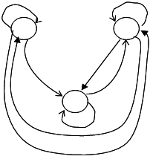
A
B
C
D
E
F
G
H
A
B
C

